Slide 1
FATIMA Daily Weather Briefing
July 7
WRF forecast
Zheqi Chen

Slide 2
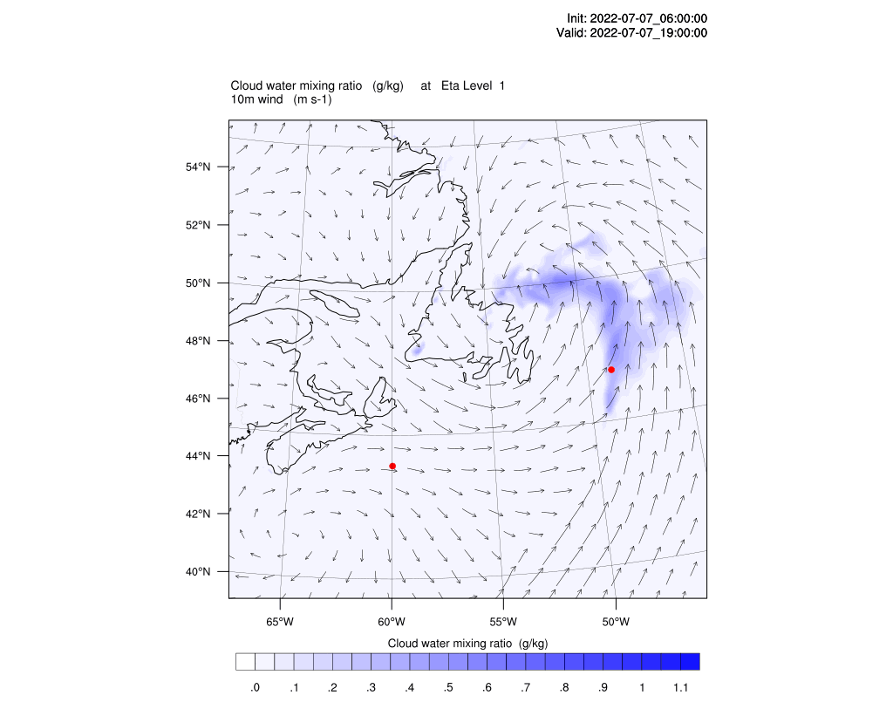
4m cloud water & 10m wind
Droplet number = 10^8/m^3 over water
As the low system moves away the two locations are clear

Slide 3
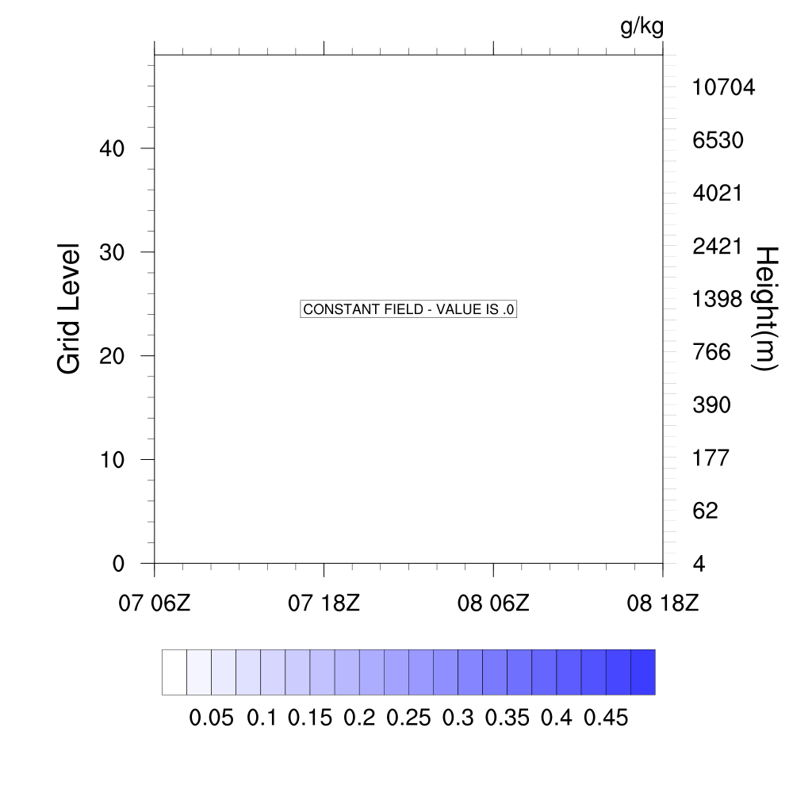
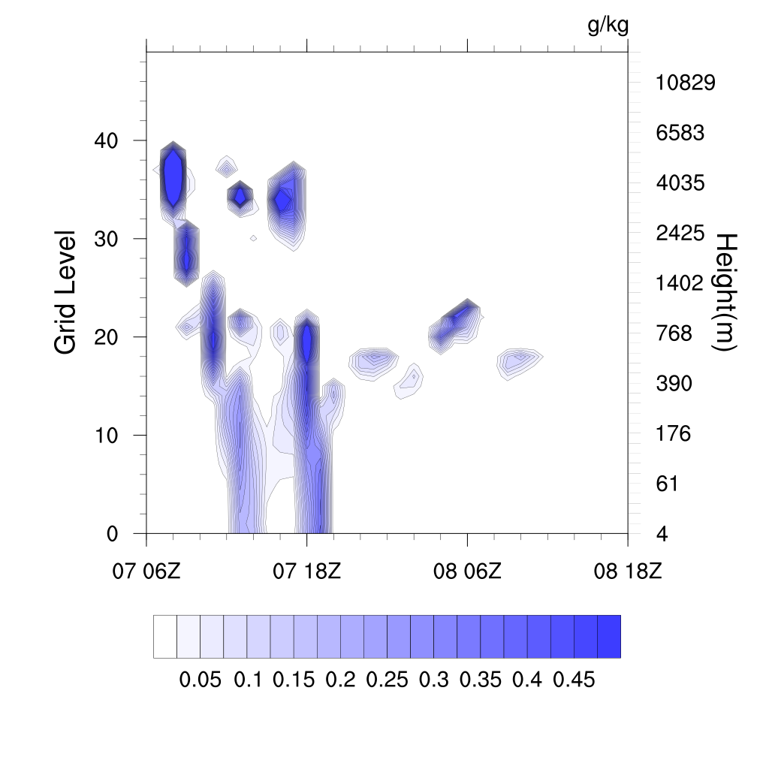
First 12 hours of the plot is spin up time
Sable Island
Hibernia

